Slide 1

Hand Made RNN

Slide 2
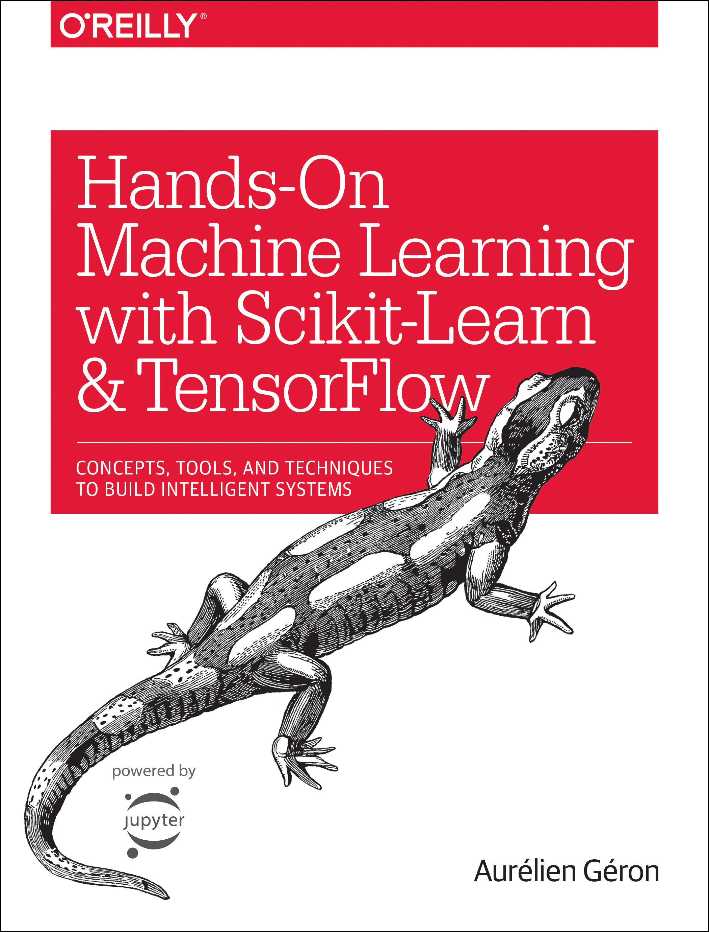
Reference
Chapter 14 (O'Reilly) of Hands-On ML
Youtube
Code

Slide 3
Data

Slide 4
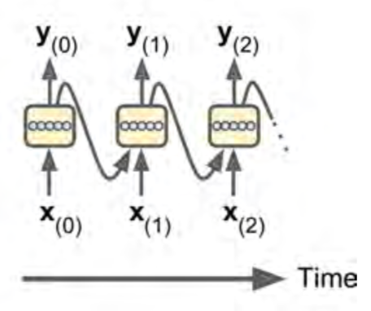
Chapter 14 (O'Reilly) of Hands-On ML

Slide 5
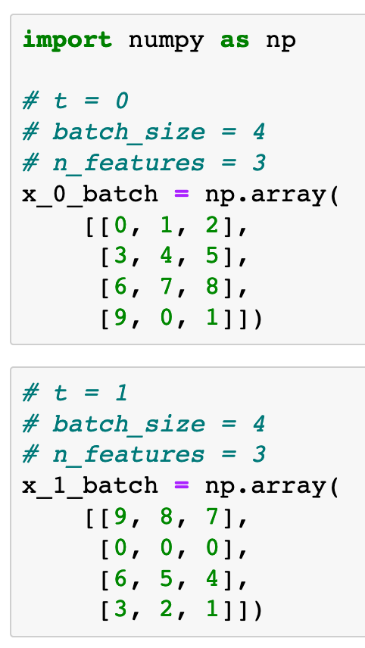

Chapter 14 (O'Reilly) of Hands-On ML

Slide 6
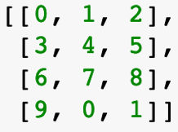
Chapter 14 (O'Reilly) of Hands-On ML

Slide 7
Chapter 14 (O'Reilly) of Hands-On ML

Slide 8
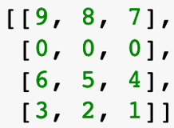
Chapter 14 (O'Reilly) of Hands-On ML

Slide 9
Graph

Slide 10
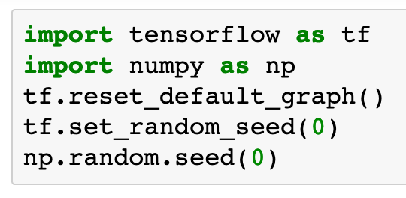

Slide 11

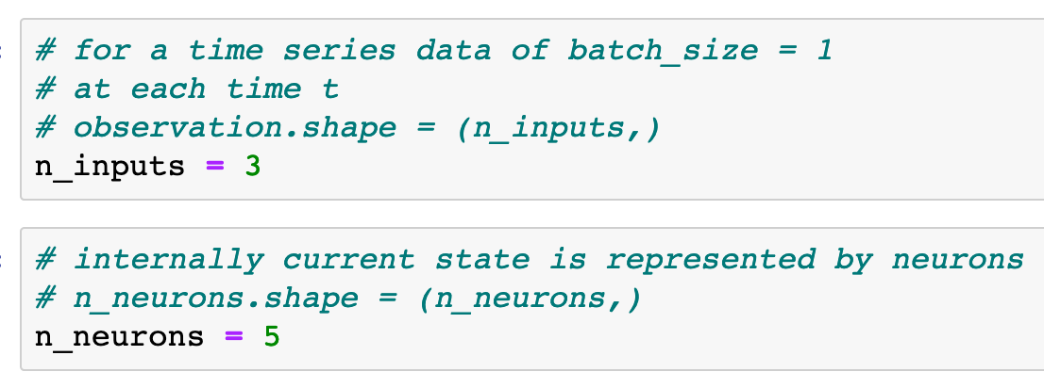
Chapter 14 (O'Reilly) of Hands-On ML

Slide 12
Chapter 14 (O'Reilly) of Hands-On ML

Slide 13
Chapter 14 (O'Reilly) of Hands-On ML

Slide 14
Chapter 14 (O'Reilly) of Hands-On ML

Slide 15
Chapter 14 (O'Reilly) of Hands-On ML

Slide 16
Chapter 14 (O'Reilly) of Hands-On ML

Slide 17
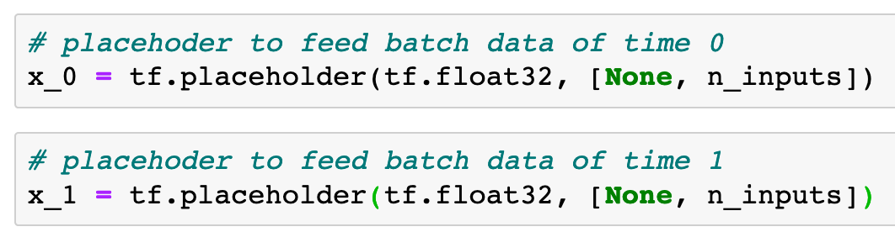
x_0
Chapter 14 (O'Reilly) of Hands-On ML

Slide 18
x_0
Chapter 14 (O'Reilly) of Hands-On ML

Slide 19
x_1
Chapter 14 (O'Reilly) of Hands-On ML

Slide 20
x_1
Chapter 14 (O'Reilly) of Hands-On ML

Slide 21
Chapter 14 (O'Reilly) of Hands-On ML

Slide 22
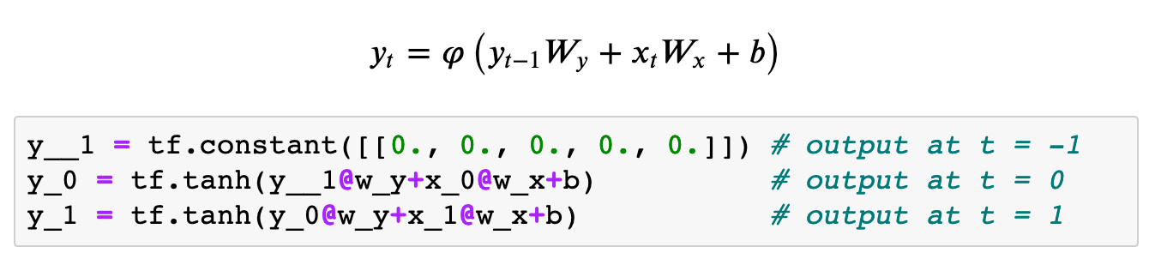

Slide 23
current input

Slide 24
previous output
current input

Slide 25
current output
previous output
current input

Slide 26
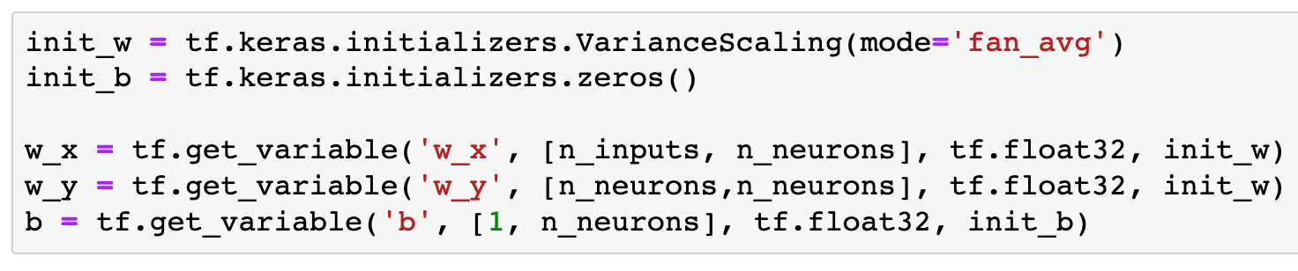

Slide 27
(?,3)

Slide 28
(?,5)
(?,3)

Slide 29
(?,5)
(?,5)
(?,3)

Slide 30
(5,5)
(?,5)
(?,5)
(?,3)

Slide 31
(5,5)
(3,5)
(?,5)
(?,5)
(?,3)

Slide 32
(5,5)
(3,5)
(1,5)
(?,5)
(?,5)
(?,3)

Slide 33
current output
previous output
current input

Slide 34
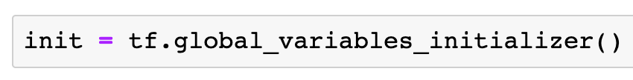

Slide 35
Session

Slide 36
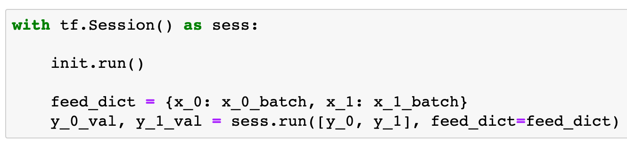
Chapter 14 (O'Reilly) of Hands-On ML

Slide 37
Chapter 14 (O'Reilly) of Hands-On ML

Slide 38
Chapter 14 (O'Reilly) of Hands-On ML

Slide 39
Chapter 14 (O'Reilly) of Hands-On ML

Slide 40
Chapter 14 (O'Reilly) of Hands-On ML

Slide 41
Chapter 14 (O'Reilly) of Hands-On ML

Slide 42
Chapter 14 (O'Reilly) of Hands-On ML

Slide 43
Chapter 14 (O'Reilly) of Hands-On ML

Slide 44
Chapter 14 (O'Reilly) of Hands-On ML

Slide 45
Chapter 14 (O'Reilly) of Hands-On ML

Slide 46
Chapter 14 (O'Reilly) of Hands-On ML

Slide 47
Report

Slide 48
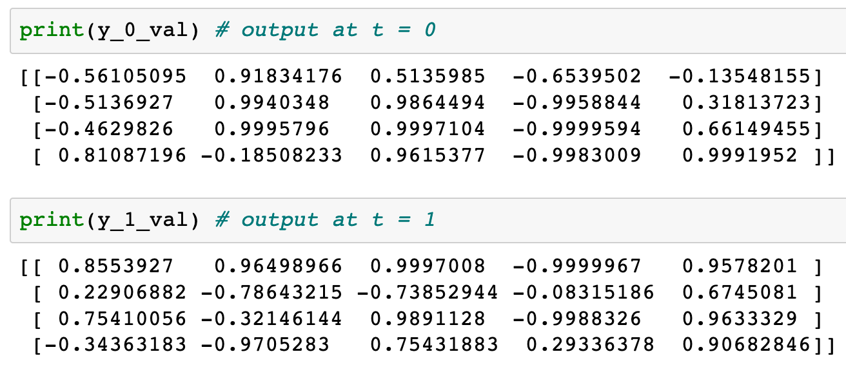
Chapter 14 (O'Reilly) of Hands-On ML

Slide 49
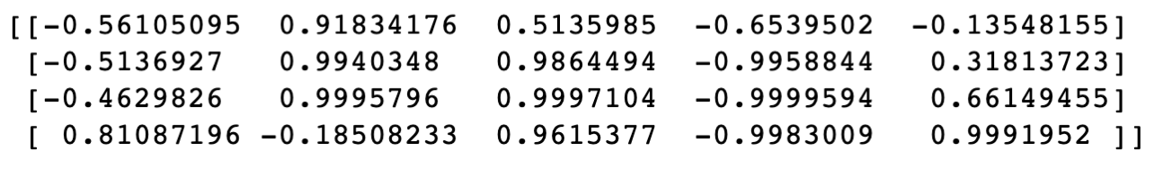
Chapter 14 (O'Reilly) of Hands-On ML

Slide 50
Chapter 14 (O'Reilly) of Hands-On ML

Slide 51
Chapter 14 (O'Reilly) of Hands-On ML

Slide 52
Chapter 14 (O'Reilly) of Hands-On ML

Slide 53
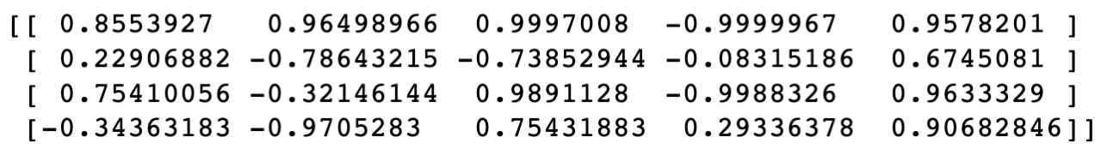
Chapter 14 (O'Reilly) of Hands-On ML

Slide 54
Chapter 14 (O'Reilly) of Hands-On ML

Slide 55
Chapter 14 (O'Reilly) of Hands-On ML

Slide 56
Now
Let’s Play with Code

